Slide 1

307401
Big Data and Data Warehouses
Introduction to Hadoop

Slide 2
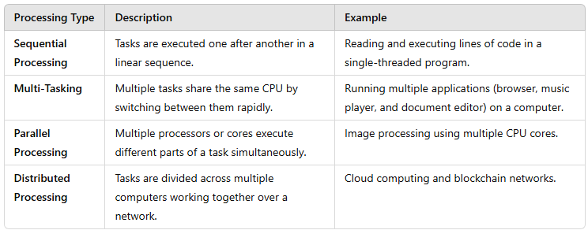
Types of Processing in Computing

Slide 3
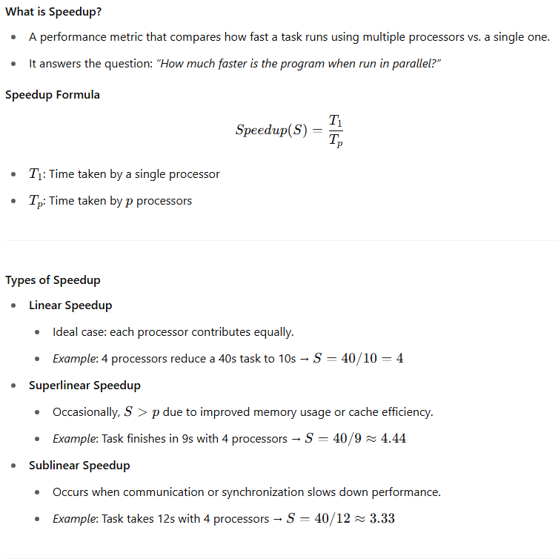
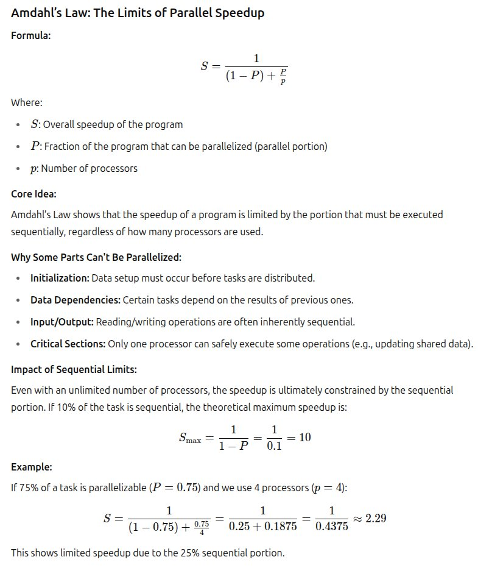
Understanding Speedup in Parallel Computing

Slide 4
Introduction to Hadoop
Hadoop is an open-source framework overseen by Apache Software Foundation which is written
in Java for storing and processing of huge datasets with the cluster of commodity hardware.
There are mainly two problems with the big data that Hadoop addresses:
The need to store huge amount of data.
The need to process that stored data.
The traditional approach like RDBMS is not sufficient due to the 5-Vs related to data.
Hadoop serve as the solution to the problem of big data i.e. storing and processing big data.

Slide 5


History of Hadoop
2002–2003: Early Beginnings
Doug Cutting and Mike Cafarella start the Nutch Project, an open-source search engine.
They encounter challenges processing large-scale web data efficiently.
2003–2004: Influence from Google
Google publishes papers on the Google File System (GFS) and MapReduce.
These papers inspire the foundational architecture for Hadoop.
2005–2006: Birth of Hadoop
Doug Cutting separates Hadoop from Nutch as its own project.
Yahoo! hires Doug Cutting and begins heavily investing in Hadoop development.
The project is named “Hadoop” after Cutting’s son’s toy elephant.
2008: Apache Hadoop Becomes Official
Hadoop becomes a top-level Apache project.
Two main components formalized:
HDFS (Hadoop Distributed File System)
MapReduce (data processing model)
Community contributions and adoption begin to accelerate.
Doug Cutting
Early Beginnings (2002-2003):
Mike Cafarella

Slide 6
History of Hadoop
2009–2011: Ecosystem Expansion
Emergence of new ecosystem projects: Hive, Pig, HBase, Zookeeper.
Formation of commercial companies like Cloudera for enterprise support.
2012–2014: Industry-Wide Adoption
Major companies such as Facebook, LinkedIn, and eBay deploy Hadoop at scale.
Release of Hadoop 2.0 with YARN (Yet Another Resource Negotiator), enabling better resource management.
Launch of Hadoop Summit, a major industry conference.
2015–Present: Modern Era
Widespread use in enterprise big data solutions.
Deep integration with cloud platforms:
AWS EMR, Google Cloud Dataproc, Azure HDInsight
Continued innovation in the ecosystem: improved performance, security, and scalability.
Impact Summary
Hadoop pioneered the Big Data revolution.
Enabled cost-effective, scalable, and distributed data processing.
Built a vibrant open-source ecosystem and community that influenced countless modern data tools.

Slide 7
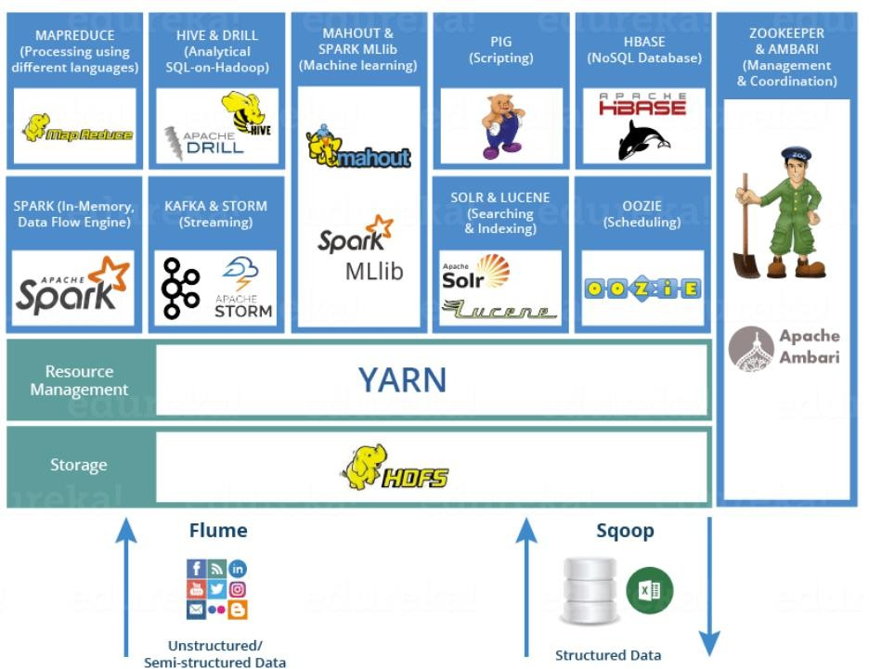
Hadoop Echo System
Hadoop ecosystem is a suite of tools and frameworks that enables Hadoop to handle large amounts of data.
Basically, Hadoop has the following three components:
HDFS (Hadoop Distributed File System): A distributed file system that provides high-throughput access to application data.
MapReduce: A framework for parallel processing of large data sets.
YARN, Resource Manager.
Other ecosystem components: Hive, Pig, HBase, Storm, Spark, Kafka, Flume, Sqoop, Oozie, Zookeeper…etc. These components work together to provide a comprehensive solution for managing and processing large data sets in a distributed computing environment.

Slide 8

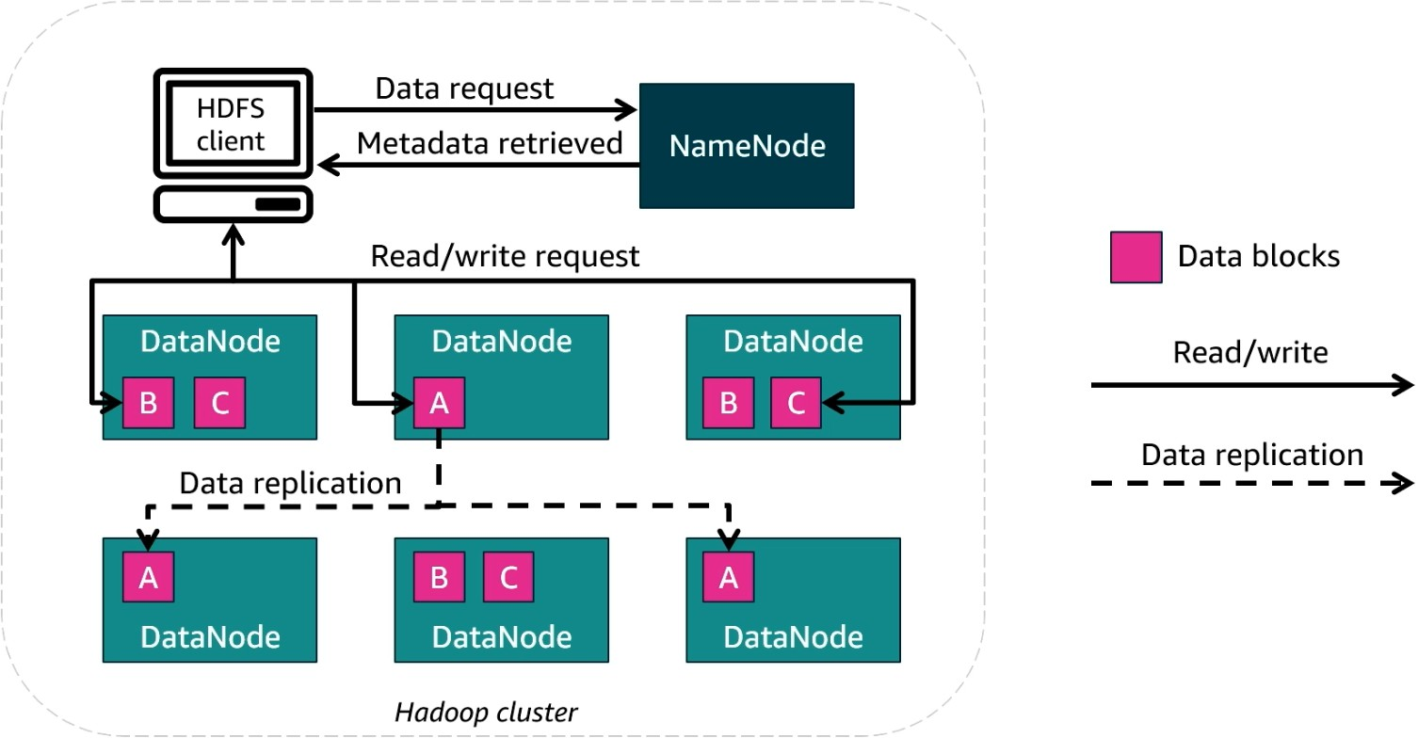
HDFS – Hadoop Distributed File System
What is HDFS?
Hadoop Distributed File System (HDFS) is the storage layer in Hadoop.
It enables distributed storage and fault tolerance by replicating data across multiple nodes.
Key Components of HDFS
1. NameNode
Acts as the master node.
Manages metadata (file locations, permissions, and structure).
Does not store actual data.
2. DataNodes
Store actual data in blocks.
Handle read/write requests from clients.
Perform data replication to ensure fault tolerance.

Slide 9
Steps When a File Is Uploaded to HDFS
Steps When a File Is Downloaded from HDFS
Client Application Initiates Upload A client application (such as a command-line tool or custom software using the HDFS API) initiates a file upload by contacting the NameNode.
NameNode Responds with Block Allocation The NameNode calculates how many blocks will be needed based on the file size and the configured block size (e.g., 128 MB) and then assigns which DataNodes should store each block and its replicas.
Client Writes Data Blocks to DataNodes The client begins writing each block to the first assigned DataNode. That DataNode then forwards the block to the second, and then the third (in a pipeline fashion) to meet the replication requirement.
Data Replication Happens Automatically Replicas of each block are written to multiple DataNodes, typically three, to ensure fault tolerance.
DataNodes Send Block Reports After storing the blocks, the DataNodes send reports back to the NameNode, confirming the block storage and replication status.
Upload Completion Once all blocks are successfully written and acknowledged, the client receives confirmation. The file is now stored and available in HDFS.
Client Application Sends Read Request to NameNode A client application (e.g., a user command or a program using the HDFS API) requests to read a file by contacting the NameNode.
NameNode Returns Block Metadata The NameNode checks its metadata and returns the list of block locations for the requested file, including the addresses of the DataNodes that store each block.
Client Reads Data Blocks from DataNodes The client directly contacts the appropriate DataNodes to read the actual data blocks. It can choose the closest replica to reduce latency.
Client Reassembles the File The client assembles the blocks in the correct order to reconstruct the full file in memory or on local storage.

Slide 10

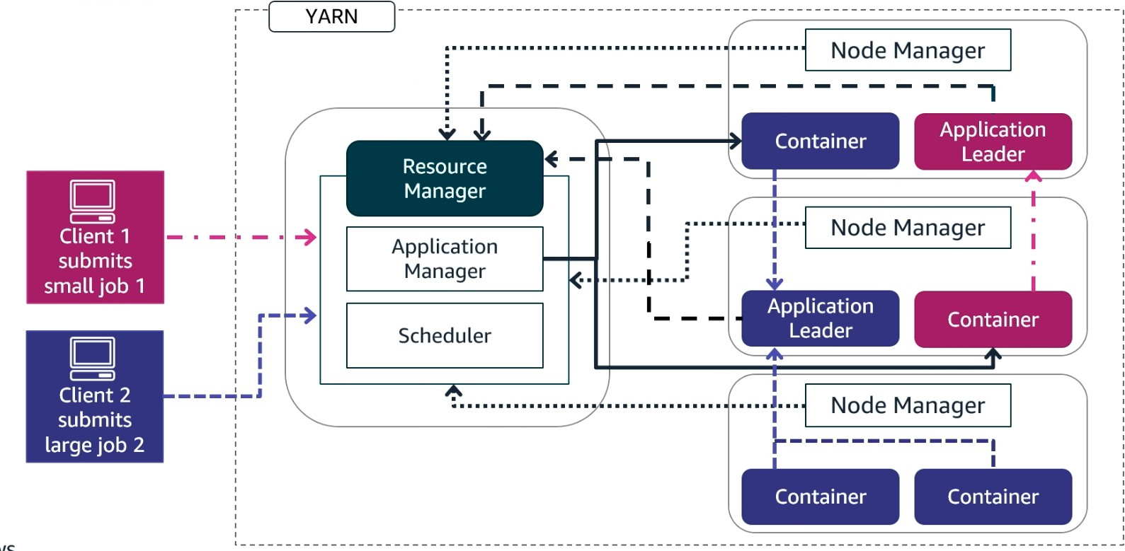
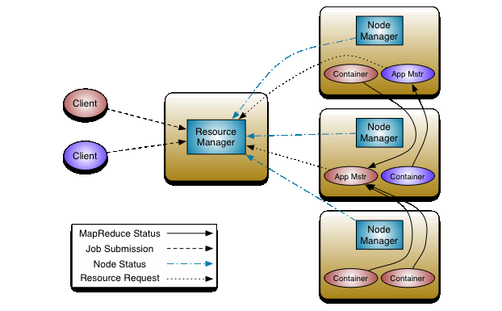
YARN, Yet Another Resource Negotiator
What is YARN?
YARN (Yet Another Resource Negotiator) is the resource management layer in Hadoop.
It efficiently allocates resources and schedules tasks for processing big data jobs.
Key Components of YARN
1. Resource Manager (RM) - Central component managing resource allocation.
It has two main parts:
Application Manager – Manages job submission and execution.
Scheduler – Allocates resources to tasks based on policies.
2. Node Managers (NM)
Runs on each DataNode to execute tasks.
Manages Containers, which are allocated resources for executing tasks.
3. Application Master (AM)
Runs within a container and coordinates job execution.
Communicates with the Resource Manager and Node Managers.

Slide 11
Steps for Resource Allocation in YARN
A client application submits a job (application) to the Resource Manager (RM). The job includes details like the amount of required resources and the type of task.
The Application Manager component of the RM registers the new application and keeps track of its status.
The Scheduler (within the RM) evaluates current cluster conditions and assigns a container on a suitable Node Manager (NM) to launch the Application Master (AM).
The Application Master running inside the allocated container is initialized. It is responsible for managing the entire job lifecycle, including requesting additional resources for task execution.
Based on the job's needs, the Application Master requests more containers from the Resource Manager to execute individual tasks (e.g., map or reduce tasks).
The Scheduler again evaluates availability and policy constraints and allocates containers on various Node Managers.
Each Node Manager launches containers and runs the assigned tasks (as directed by the Application Master). Tasks process data and perform computations.
The Application Master monitors task completion, handles retries if needed, and reports status back to the Resource Manager.
Once all tasks finish, the final output is either returned to the client or stored in HDFS, and the Application Master deregisters from the RM.

Slide 12

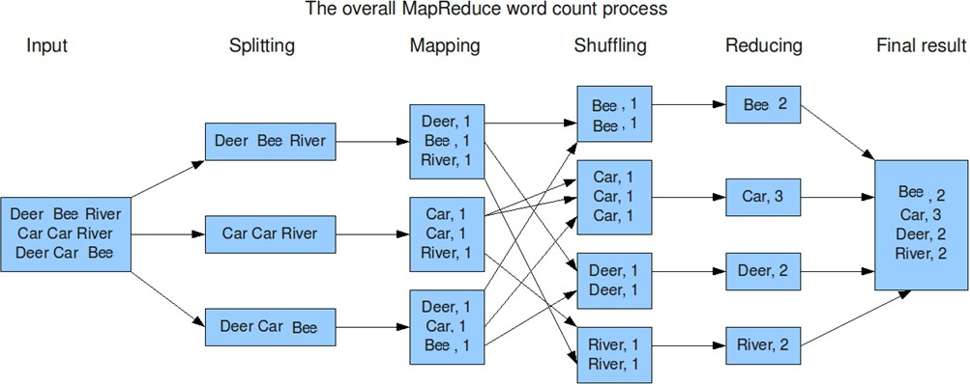
MapReduce: Distributed Big Data Processing Framework
MapReduce is a programming model and framework for processing massive datasets across distributed clusters using parallel computation.
Key Components:
Mapper: Processes input data chunks and transforms them into intermediate key-value pairs
Reducer: Aggregates and combines intermediate data by key to produce final results
YARN ApplicationMaster: Coordinates job execution and resource management
HDFS Integration: Provides distributed storage for input/output data
Technical Workflow:
Input Splitting: Data divided into blocks (typically 128MB) across HDFS nodes
Map Phase: Parallel Mapper tasks process splits → intermediate key-value pairs
Shuffle & Partition: Framework redistributes data by key across cluster nodes
Sort & Group: Intermediate data sorted and grouped by key for each Reducer
Reduce Phase: Reducer tasks aggregate values per key → final output to HDFS
Key Advantages:
Fault Tolerance: Automatic task retry and data replication
Scalability: Handles petabyte-scale datasets across thousands of nodes
Framework Integration: Works with Hadoop ecosystem (Hive, Pig, Spark)
Real-World Applications:
Log analysis for fraud detection (Facebook, Google)
Search index generation and web crawling
Financial risk analysis and recommendation systems
Modern Context: While Spark has largely replaced MapReduce for many use cases, MapReduce remains fundamental for batch processing in enterprise Hadoop environments.

Slide 13
Steps in the MapReduce Execution Process
1. Job Submission by Client
A client application submits a MapReduce job to the YARN Resource Manager, including input file paths, Mapper/Reducer JAR files, and configuration parameters.
2. ApplicationMaster Launch
YARN Resource Manager allocates a container on a selected Node Manager and launches a MapReduce ApplicationMaster inside that container to coordinate the specific job execution.
3. Input Splitting by InputFormat
The MapReduce InputFormat class (e.g., TextInputFormat) logically splits the input data into input splits based on HDFS block boundaries (typically 128 MB per split) to enable parallel processing.
4. Mapper Task Launch and Resource Allocation
The ApplicationMaster requests containers from YARN Resource Manager and launches Mapper tasks inside allocated containers across Node Managers. Each Mapper processes one input split.
5. Map Phase Execution
Individual Mapper tasks read their assigned input splits from HDFS DataNodes and execute user-defined map functions to generate intermediate key-value pairs (e.g., (word, 1)).
6. Local Combiner Phase (Optional)
Combiner functions (if configured) run locally within each Mapper's JVM to pre-aggregate intermediate data, reducing network traffic during shuffle.

Slide 14
Steps in the MapReduce Execution Process
7. Shuffle, Partition, and Sort Operations
Partitioning: The MapReduce Partitioner determines which Reducer should receive each key, usually using hash partitioning.
Intermediate Data Storage: Mappers write partitioned key-value data to local disk, organized by Reducer target.
Shuffle (Data Transfer): Each Reducer pulls its partition of data over HTTP from all Mapper nodes' local disks. This transfer is managed by the NodeManager's Shuffle Service (embedded HTTP server).
Sort and Grouping: Reducers merge, sort, and group the fetched data by key, so that all values for a key are grouped together before being passed to the reduce() function.
8. Reducer Task Launch
The ApplicationMaster requests additional containers from YARN Resource Manager and launches Reducer tasks in allocated containers across Node Managers.
9. Reduce Phase Execution
Individual Reducer tasks receive grouped, sorted key-value pairs for specific key ranges and execute user-defined reduce functions to aggregate values (e.g., (Car, [1,1,1]) → (Car, 3)).
10. Final Output to HDFS
Reducer tasks write final results through HDFS DataNodes to the specified output directory using OutputFormat classes (e.g., TextOutputFormat), completing the MapReduce job execution.
Key Components Clarified:
YARN: Resource allocation and container management
ApplicationMaster: Job coordination and task lifecycle management
MapReduce Framework Classes: InputFormat, Partitioner, Combiner, OutputFormat
NodeManager Services: Container execution and shuffle data transfer
HDFS: Distributed storage for input/output data

Slide 15

Real-World Use Case: Log Analysis for Ad Click Fraud Detection
Company Example: Facebook
Objective: Detect fraudulent ad clicks by analyzing massive volumes of server logs. Data Source: Web server logs from Facebook's ad delivery infrastructure. Scale: Billions of clicks daily across millions of IP addresses
Data Structure (Sample Log Entry):
{ "timestamp": "2025-03-20T14:33:21Z",
"user_id": "u98374",
"ad_id": "ad4562",
"ip_address": "192.168.1.5",
"click": true,
"device_type": "mobile",
"location": "New York, USA"}

Slide 16
Processing with MapReduce – Facebook Example
Map Phase (What We're Mapping):
Input: Individual log entries
Mapper Logic:
Extract key fields: ip_address, timestamp, user_id, ad_id
Emit key-value pairs: (ip_address, "timestamp|user_id|ad_id")
Example output: ("192.168.1.5", "14:33:21|u98374|ad4562")
Shuffle & Group:
Framework groups all clicks by IP address:
("192.168.1.5", ["14:33:21|u98374|ad4562", "14:33:45|u98374|ad4562", "14:34:12|u98374|ad4562"])
Reduce Phase (What We're Reducing):
Input: All clicks grouped by IP address
Reducer Logic:
Count total clicks per IP: click_count = list.length
Calculate click velocity: clicks_per_minute = count / time_window
Detect patterns: Same user_id + rapid clicking + same ad_id
Output: ("192.168.1.5", "count=47, velocity=15.7/min, fraud_score=0.89")
Outcome:
Fraud Detection: IPs with >10 clicks/minute + same user patterns = HIGH FRAUD RISK
Action: Block suspicious IPs and preserve legitimate ad revenue
Business Value: Protects millions in advertising spend daily
Key Insight: We're mapping each click event to its IP address and reducing by aggregating all clicks per IP to detect abnormal patterns that indicate bot activity.

Slide 17

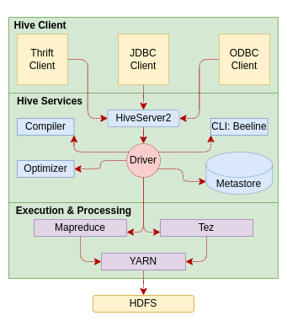
Apache Hive
What is Hive?
Hive is a data warehouse system built on top of Hadoop.
It allows querying and managing large datasets using a SQL-like language called HiveQL.
Created by Facebook to simplify complex MapReduce programming for analysts.
Why Hive?
Writing raw MapReduce code in Java is complex and time-consuming.
Hive allows users to write declarative queries in HiveQL.
Hive compiles these queries into efficient MapReduce tasks.
Hive Architecture
Metastore: Stores metadata about Hive tables (schemas, locations, etc.).
Driver: Manages the lifecycle of a HiveQL query and its execution plan.
Compiler: Translates HiveQL into MapReduce jobs to run on Hadoop.

Slide 18

Real-World Use Case: Marketing Campaign Analysis
Company Example:
Objective: Analyze customer behavior to evaluate marketing campaign effectiveness.
Data Source: User activity logs stored in HDFS, including views, clicks, watch duration, and subscription status.
Data Structure (Hive Table Schema):
CREATE TABLE user_activity ( user_id STRING, timestamp TIMESTAMP, action STRING, -- e.g., "play", "pause", "subscribe", "click_ad" content_id STRING, device_type STRING, campaign_id STRING) ROW FORMAT DELIMITED FIELDS TERMINATED BY ',' STORED AS TEXTFILE;
Processing with Hive (HiveQL):
Perform aggregations:
Total views per campaign
Conversion rates from ad click to subscription
Device-specific campaign performance
Sample Query:
SELECT campaign_id, COUNT(*) AS views, SUM(CASE WHEN action = 'subscribe' THEN 1 ELSE 0 END) AS subscriptions FROM user_activity WHERE action IN ('click_ad', 'subscribe’) GROUP BY campaign_id;
Outcome:
Identifies high-performing campaigns and channels.
Supports data-driven decisions for targeting and ad spend allocation.
Let me know if you'd like this turned into a presentation slide or want a Hive use case from retail, telecom, or IoT.

Slide 19


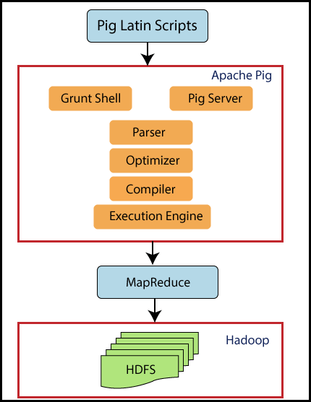
Apache PIG – High Level SQL Like Language on top of Hadoop
Run on Hadoop and translates Pig Latin scripts into MapReduce jobs.
Created by to solve MapReduce challenges
Pig Latin is a high-level data processing language that simplifies writing complex MapReduce code directly, this allows users to work with big data using simpler syntax compared to Map Reduce.
Used for data transformations and analysis tasks over large datasets in Hadoop.
Architecture:
Pig Latin Scripts: Define data transformation tasks.
Pig Engine: Executes these scripts on Hadoop.
https://www.analyticsvidhya.com/blog/2022/06/getting-started-with-apache-pig/
Hive vs Pig

Slide 20

Real-World Use Case: Web Log Processing for User Behavior Analysis
Company Example: LinkedIn (used Pig before transitioning to Spark)
Objective: Analyze web server logs to understand user navigation paths and session behavior.
Data Source:
Daily web server log files stored in HDFS.
Data Structure (Sample Log Fields):
timestamp, user_id, session_id, page_url, referrer_url, device_type
Example Data:
2025-03-22T12:01:45Z, u12345, s7890, /jobs, /home, mobile
Processing with Apache Pig:
Load and Transform Logs:
logs = LOAD '/logs/2025/03/22' USING PigStorage(',') AS (timestamp:chararray, user_id:chararray, session_id:chararray, page_url:chararray, referrer_url:chararray, device_type:chararray);
Group and Analyze Sessions:
grouped = GROUP logs BY session_id; session_counts = FOREACH grouped GENERATE group AS session_id, COUNT(logs) AS page_views;
Filter High-Engagement Sessions:
engaged_sessions = FILTER session_counts BY page_views > 5;
Outcome:
Identifies highly engaged users and frequent navigation paths.
Insights used for UX improvements and targeted content placement.

Slide 21

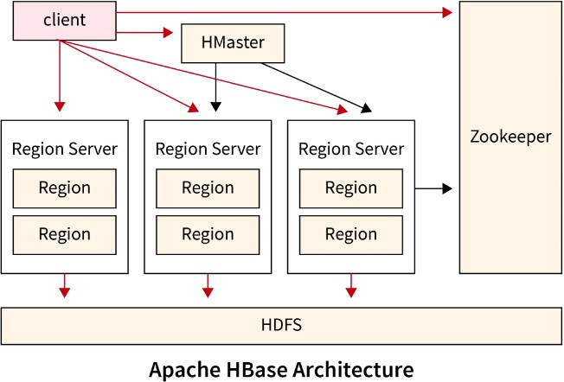
Apache HBase - Distributed Database on top of Hadoop
What is HBase?
HBase is a distributed, column-oriented NoSQL database built on top of Hadoop HDFS.
Designed for sparse, semi-structured, and unstructured data.
Provides real-time read/write access to large datasets.
Inspired by Google's Bigtable.
Apache HBase Architecture
HMaster: Manages the cluster.​
RegionServer: Handles read/write requests for regions of the database.​
ZooKeeper: Manages distributed coordination.​
https://www.scaler.com/topics/hadoop/hbase-architecture/

Slide 22
Insert Data in HBase
In HBase, we create tables and define column families.
create 'employees', 'personal', 'job' | Create a table named employees with two families (personal and job)
Then we insert values
put 'employees', 'emp1', 'personal:name', 'Alice' | emp1 has only name in personal
put 'employees', 'emp2', 'personal:phone', '123456789' | emp2 has only phone in personal
put 'employees', 'emp3', 'job:salary', '60000' | emp3 has only salary in job, no personal column family
Notice that must comply with column families when we insert data into the table.
But we can use different column names within the column family e.g.
✅ Schema-less? | Yes, for columns (qualifiers) – flexible and dynamic.
🧱 Schema-fixed? | Yes, for column families – must be defined when the table is created.

Slide 23
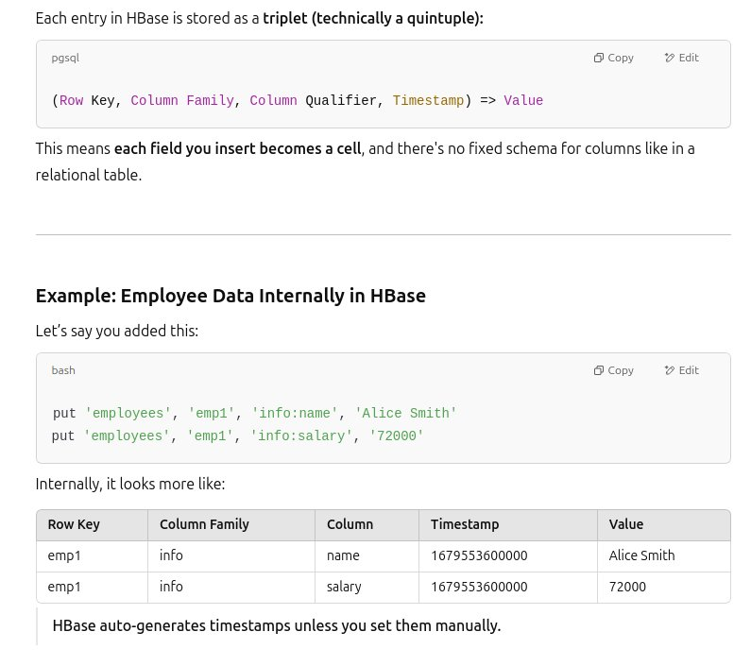
Key Concepts
Row Key: Unique identifier for each row (like a primary key).
Column Family: Logical group of columns stored together on disk.
Column Qualifier: Actual field name inside a column family.
Timestamp: Each cell value is versioned by time.
Cell: Combination of Row Key + Column Family + Qualifier + Timestamp → Value.

Slide 24

Real-World Use Case: Messaging Platform – Real-Time Message Storage & Retrieval
Company Example: WhatsApp
Objective: Store and retrieve billions of real-time chat messages with low latency and high throughput.
Data Source: User chat messages from mobile devices, synced to a backend service.
Data Structure (HBase Table Design):
Table: messages
Row Key: user_id + timestamp
Column Families:
meta: sender_id, receiver_id, message_type
content: message_type, attachments
status: delivered, read, timestamp
Sample Record (in HBase):
Row Key: user123|2025-03-22T14:33:21Z Column Family: meta - sender_id: user123 - receiver_id: user456 Column Family: content - message_text: individual
Column Family: status - delivered: true - read: false
Processing with HBase:
Messages are written and read with low latency.
Efficient for real-time features: chat history retrieval, unread message counts.
Scales horizontally to billions of rows (messages) per day.
Outcome:
Ensures seamless chat experience across devices.
Supports real-time sync, delivery status tracking, and storage durability.

Slide 25
HBase vs Relational DB
Feature | HBase | Relational DB
Schema | Flexible (schema-less columns) | Fixed schema
Row Structure | Rows can have different columns | Rows have same set of columns
Access Pattern | Real-time random read/write | Typically, transactional
Query Language | API (Java, REST, Thrift) | SQL
Storage Model | Column-oriented, sparse | Row-oriented
Best Use Case | Time-series, logs, IoT, real-time | Structured, normalized data

Slide 26

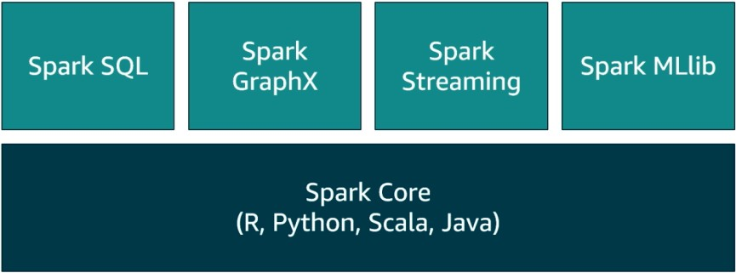
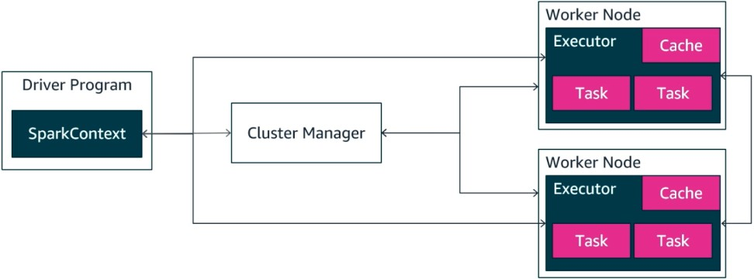
Apache Spark
Definition:
Apache Spark is an open-source distributed data processing engine optimized for large-scale data processing.
In-Memory Processing: Spark keeps data in memory between transformations, speeding up processing times significantly compared to disk-based MapReduce.
Spark can handle both batch and real-time processing.
Spark offers APIs for various languages (Java, Scala, Python, R).
Core Components:
Spark Core: The foundation for Spark’s API, handling basic data processing and distributing tasks across the cluster.
Spark SQL: Enables SQL-like queries on data stored in distributed datasets (DataFrames and Datasets).
Spark Streaming: Allows processing of real-time data streams, enabling near real-time analytics.
MLlib: Spark’s machine learning library, offering tools for scalable machine learning.
GraphX: A graph processing library for large-scale graph computations.

Slide 27
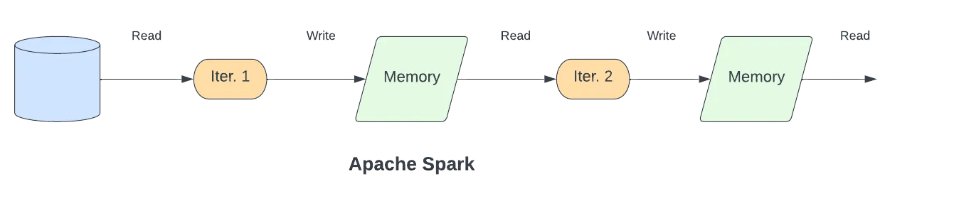
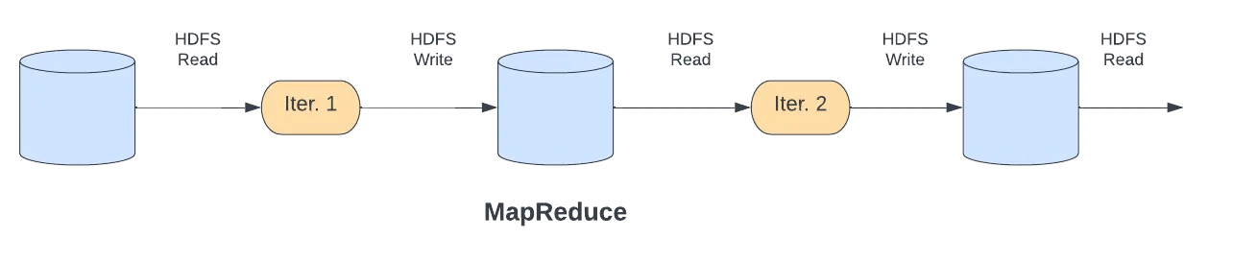
MapReduce vs. Spark
MapReduce – First-Generation Framework
A disk-based distributed processing system designed for large-scale, fault-tolerant batch computation.
Follows a linear execution model:
Read data from HDFS
Apply map() function
Write intermediate data to disk
Shuffle and sort
Apply reduce() function
Write final output to HDFS
Every phase involves reading from and writing to disk, which increases latency.
Suitable for simple, one-pass data processing but inefficient for iterative tasks like machine learning or graph algorithms.
Key Limitation: Disk I/O at every stage leads to poor performance for multi-stage workflows.
Apache Spark – Third-Generation Framework
An in-memory distributed processing engine that improves on MapReduce's model.
Uses Resilient Distributed Datasets (RDDs) to manage distributed data in memory.
Supports chaining multiple transformations without writing intermediate results to disk.
Writes to disk only when necessary (e.g., final output or fault recovery).
Key Advantage: Significantly faster than MapReduce for iterative and interactive workloads.
https://www.redpanda.com/blog/data-stream-processing-spark-flink-ksqldb

Slide 28

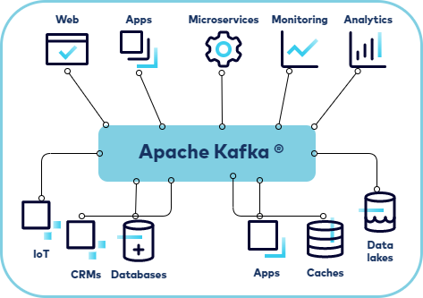
Apache Kafka – Messaging System
Apache Kafka is a distributed event streaming platform designed to handle high-throughput, real-time data feeds.
Originally developed by LinkedIn, Kafka has become the backbone for data pipelines and real-time analytics in many large-scale systems.
It serves as a message broker that allows various applications to produce and consume streams of data reliably, efficiently, with low latency and at scale.
Architecture:
Producer: An application that sends data to Kafka topics.
Consumer: An application that reads data from Kafka topics.
Broker: A Kafka server that stores data and serves it to consumers.
Kafka clusters consist of multiple brokers.
Topic: A category or feed name to which records are published. Each topic can have multiple partitions, helping Kafka to parallelize data across the cluster.

Slide 29
Kafka in E-Commerce Order Processing
Scenario:
An online store uses Kafka to manage orders, inventory, payments, and shipping in real time.
Process Flow:
A customer places an order on the storefront (website/app).
The order details are sent to the Kafka orders topic.
The Order Processing Service consumes the order, checks inventory, and verifies payment.
If items are in stock, the order is confirmed, and a message is sent to the Inventory & Payment topics.
Once the payment is confirmed, the Shipping Service picks up the order details from Kafka and generates a shipment.
The Customer Notification Service listens for updates and sends notifications.

Slide 30
Kafka in E-Commerce Order Processing – Extended Example
1. Order Initiation - The Story Begins
What's happening: Sarah is shopping on your e-commerce website. She's added a few items to her cart - a blue sweater, some headphones, and a coffee mug. After reviewing everything, she clicks the "Place Order" button.
Behind the scenes: The moment Sarah hits that button, your website (the Online Storefront) springs into action. It's like a cashier at a store who just received Sarah's order and now needs to tell everyone else in the company about it.
The Handoff: The website doesn't try to handle everything itself. Instead, it creates a detailed "order slip" with all of Sarah's information:
A unique order number (like #ORD-12345)
Sarah's details (name, email, shipping address)
What she ordered (blue sweater size M, wireless headphones, ceramic mug)
How many of each item
The total amount she needs to pay ($89.97)
This is like posting a message on a company bulletin board that says "New order just came in!" - except it's instant and digital.
The Announcement: The website then puts this order slip into a digital "mailbox" called the orders topic in Kafka.
Why this matters: By putting the order into this shared mailbox, the website is essentially saying "Hey, Order Processing team, we've got a new order for you to handle!" The website's job is done - it just needs to pass the baton to the next person in line.

Slide 31
Kafka in E-Commerce Order Processing – Extended Example
2. Order Validation & Processing
Trigger: New order event received
Actor: Order Processing Service
Actions:
Validates order details
Checks customer information
Requests inventory check
Decision Point: Is order valid?
Valid: Continue to inventory check
Invalid: Send failure notification
3. Inventory Check & Reserve
Trigger: Order validation complete
Actor: Order Processing Service → Inventory Management Service
Action: Publishes inventory request to inventory topic
Response: Inventory Management Service confirms/denies availability
Decision Point: Items available?
Available: Reserve items, continue to payment
Unavailable: Cancel order, notify customer
4. Payment Processing
Trigger: Inventory reserved
Actor: Order Processing Service → Payment Gateway
Action: Initiates payment processing
Response: Payment Gateway publishes result to payments topic
Decision Point: Payment successful?
Success: Mark order as paid, proceed to fulfillment
Failure: Release inventory, cancel order, notify customer
5. Shipping Preparation
Trigger: Payment confirmed
Actor: Order Processing Service → Shipping Service
Action: Publishes shipping request to shipping topic
Data: Order details, shipping address, delivery preferences
Result: Shipping Service creates shipment and assigns tracking number
6. Warehouse Fulfillment
Trigger: Shipping request received
Actor: Warehouse System
Actions:
Picks items from inventory
Packages order
Updates inventory levels (publishes to inventory topic)Hands off to shipping provider

Slide 32
E-commerce Order Processing Flow
7. Shipping & Delivery Tracking
Trigger: Package dispatched
Actor: Shipping Provider
Actions:
Updates delivery status
Publishes tracking updates to shipping topic
Provides delivery confirmation
8. Customer Notifications (Parallel Throughout)
Trigger: Various status changes
Actor: Customer Notification Service
Listens to: notifications topic
Actions:
Order Confirmed
Payment processed
Order shipped
Out for delivery
Delivered
Channels: Email, SMS, push notifications

Slide 33
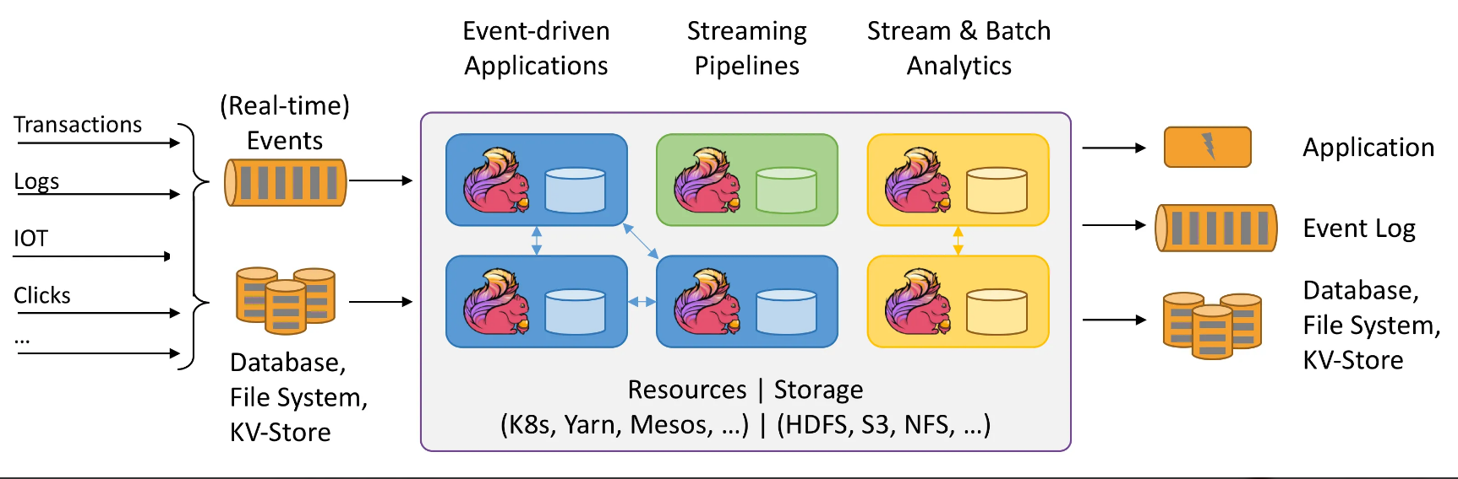
Apache Flink
What is Apache Flink?
Open-source, distributed stream & batch processing system
Originally developed by the Stratosphere project, now under Apache Software Foundation
Processes high-velocity data with low latency, exactly-once semantics, and strong fault tolerance
Architecture
Sources – Data ingestion from Kafka, databases, files
Transformations – Stateful operations like filtering, aggregations, and joins
Sinks – Writing processed data to Kafka, databases, or data lakes
Stateful Processing – Uses checkpoints and savepoints for fault tolerance
Event Time Processing – Handles late-arriving data with watermarks
Use Cases
Real-time analytics – Log analysis, anomaly detection, monitoring
Event-driven applications – Dynamic data enrichment, alerting
ETL pipelines – Continuous data processing and transformation
Machine learning – Real-time model inference and training

Slide 34

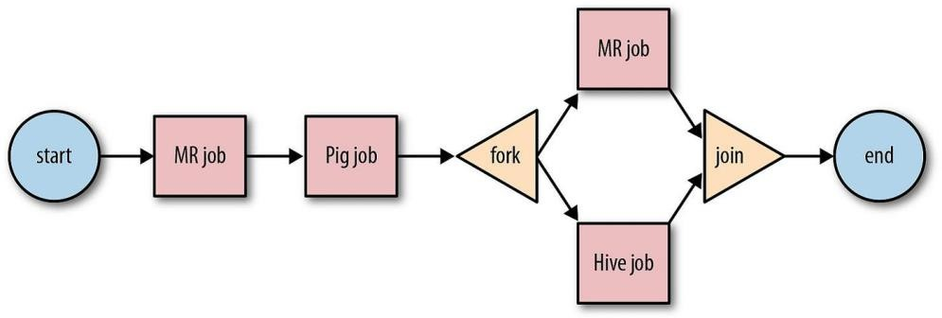
Apache Oozie
Apache Oozie is a workflow orchestration system designed to manage and coordinate Hadoop jobs in a sequence or directed acyclic graph (DAG). It provides end-to-end workflow management for big data pipelines, making it easier to automate complex multi-step data processing tasks.
Key Features
Workflow Scheduling: Define and run workflows consisting of multiple Hadoop jobs (e.g., MapReduce, Hive, Pig, Sqoop).
Dependency Management: Manage job dependencies and ensure tasks run in the correct order.
Trigger Support: Supports both time-based triggers (e.g., hourly, daily) and data availability-based triggers.
Error Handling & Retry: Automatically retries failed jobs and handles exceptions through recovery mechanisms.
Flexible Integration: Works with various Hadoop components and supports shell scripts, Java programs, and custom actions.
Common Use Cases
Automating ETL pipelines (Extract, Transform, Load)
Managing daily batch processing jobs
Scheduling data ingestion workflows using Sqoop or Flume
Orchestrating multi-tool data flows (e.g., Hive → Pig → MapReduce)
Real-Life Use Case
Enterprise Data Warehouse Refresh:
A retail company uses Apache Oozie to automate the nightly refresh of their enterprise data warehouse. The workflow includes:
Importing sales data from relational databases into HDFS using Sqoop.
Cleansing and transforming data using Hive queries.
Aggregating key metrics with MapReduce.
Loading results into a Hive-based reporting table.
Triggering email alerts if a job fails or data thresholds are not met.
This allows the analytics team to have up-to-date insights each morning, without manual intervention.

Slide 35

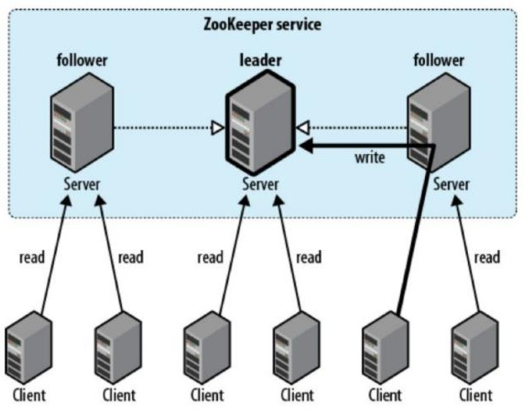
Apache Zookeeper
Apache ZooKeeper is a centralized service designed for coordinating distributed applications.
ZooKeeper plays a critical role in the Hadoop ecosystem and other distributed systems by helping to maintain the distributed state and providing a reliable way for services to work together.
Key Features of Apache ZooKeeper
Centralized Configuration Management: ZooKeeper stores configuration data in a centralized manner, allowing distributed applications to access and modify configuration settings easily.
Naming Service: It provides a naming registry for distributed services, allowing them to find each other and manage resources dynamically.
Synchronization: ZooKeeper helps synchronize distributed processes, ensuring they work in coordination and without conflicts.
Group Management: Supports the creation and management of groups, enabling services to join and leave groups dynamically.
Watchers: ZooKeeper can set watchers on nodes to get notified of changes, allowing applications to react to changes in state.

Slide 36

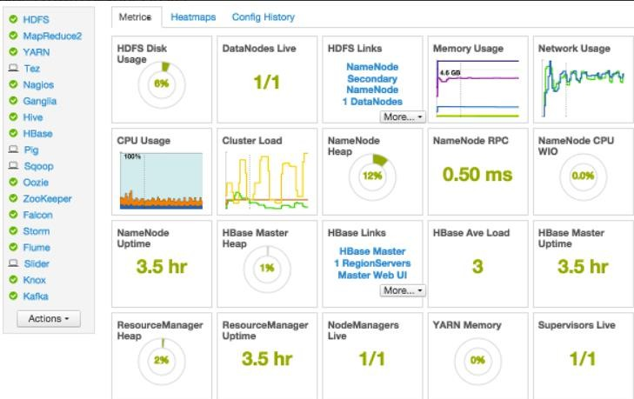
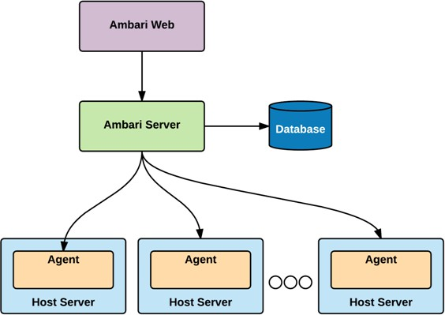
Apache Ambari
Apache Ambari is a web-based tool designed for provisioning, managing, and monitoring Apache Hadoop clusters.
It provides a user-friendly interface that simplifies the management of complex Hadoop environments, making it easier for administrators and operators to deploy and manage various components of the Hadoop ecosystem.
Key Features of Apache Ambari
Cluster Provisioning: Ambari simplifies the installation and configuration of Hadoop clusters, allowing users to easily add or remove nodes and services through a guided installation wizard.
Service Management: Users can start, stop, and restart various Hadoop services (such as HDFS, YARN, Hive, HBase, etc.) through the Ambari interface.
Monitoring and Alerts: Ambari provides dashboards for real-time monitoring of cluster health, service metrics, and resource usage. It also supports setting up alerts for various cluster events or metrics.
Configuration Management: It allows for easy management of configuration settings for Hadoop services, including the ability to apply configurations in a centralized manner.
User Management: Administrators can manage users and their permissions, ensuring secure access to cluster resources and configurations.
Integration with Ambari Metrics and Alerts: Supports the collection and visualization of metrics from different Hadoop components, allowing for comprehensive monitoring and alerting.

Slide 37
Final Notes

Slide 38
Main Hadoop Components
Category / Component | Description
Storage Components
HDFS | Distributed file system for scalable and fault-tolerant data storage.
HBase | NoSQL database for real-time read/write access to large datasets.
Phoenix | SQL layer on top of HBase for low-latency OLTP and analytics.
Batch Processing
MapReduce | Traditional batch processing model for parallel computation on large data.
Tez | DAG-based execution engine; faster alternative to MapReduce.
Hive | SQL-like interface for querying large datasets, often runs on Tez or Spark.
Pig | Dataflow scripting platform using Pig Latin for batch data processing.
Impala | MPP (Massively Parallel Processing) SQL query engine for real-time, interactive querying on Hadoop data.
Real-Time / Stream Processing
Spark Streaming | Micro-batch stream processing engine within Apache Spark.
Flink | True stream processing engine with high throughput and low latency.
Storm | Distributed real-time computation system for event-driven processing.
Data Ingestion & Integration
Sqoop | Imports/exports structured data between Hadoop and relational databases.
Flume | Collects and transports large volumes of log or event data.

Slide 39
Main Hadoop Components
Category / Component | Description
Security & Governance
Ranger | Centralized security for authorization, policies, and auditing.
Knox | Gateway that provides perimeter security and REST API access to Hadoop.
Atlas | Metadata management and data governance framework.
Machine Learning & Search
Mahout | Scalable machine learning library for classification, clustering, etc.
Solr | Enterprise search platform; supports full-text search on Hadoop data.
Cluster Coordination
YARN | Resource management layer for job scheduling and cluster resource utilization.
Zookeeper | Coordination service for configuration, synchronization, and leader election.
Serialization & File Formats
Avro | Row-based data serialization framework with schema support.
Parquet | Columnar storage format optimized for performance and compression.
ORC | Columnar storage format optimized for Hive; enables efficient querying.
UI, Workflow & Dev Tools
Oozie | Workflow scheduler to orchestrate complex Hadoop jobs.
Ambari | Web UI for provisioning, monitoring, and managing Hadoop clusters.
Hue | Web-based user interface for querying and interacting with Hadoop tools.
Zeppelin | Interactive data analytics notebook that supports Spark, SQL, and more.

Slide 40
Big Data Components in AWS EMR
Category | Application | Description
Big Data Engines | Apache Spark | Fast in-memory distributed data processing for large-scale workloads.
 | Hadoop | Core framework for distributed storage (HDFS) and processing (MapReduce/YARN).
 | Flink | Real-time stream processing framework with high throughput and low latency.
 | HBase | NoSQL database for real-time read/write access on HDFS.
 | Presto | Distributed SQL query engine for large-scale interactive queries.
 | Trino | High-performance distributed SQL engine (PrestoSQL fork).
Notebook Interfaces | JupyterEnterpriseGateway | Enables remote access to Jupyter kernels on distributed clusters.
 | JupyterHub | Multi-user Jupyter notebook server.
SQL/Data Warehousing | Hive | SQL-like interface for querying large datasets on Hadoop.
 | HCatalog | Table and metadata management layer for Hive.
Workflow Management | Oozie | Workflow scheduler system to manage Hadoop jobs.
 | Tez | Framework for building data processing tasks on YARN.
Streaming & Interfaces | Livy | REST API for interacting with Spark.
 | Zeppelin | Web-based notebook for data exploration and visualization.
Scripting | Pig | High-level scripting platform for Hadoop.
Monitoring | AmazonCloudWatchAgent | Sends system metrics and logs to Amazon CloudWatch.
Machine Learning | TensorFlow | Open-source machine learning framework by Google.
Data Management | Hue | Web UI for Hadoop ecosystem (Hive, Pig, HDFS, etc.).
Coordination Services | ZooKeeper | Coordination service for distributed applications.

Slide 41
Distributed Processing vs. Massive Parallel Processing (MPP)
Distributed Processing
General Concept: Any system where multiple computers (or nodes) work together to process data.
Used in: Hadoop (MapReduce), Spark, Flink, Storm, etc.
How it works: The workload is split into chunks and processed in parallel across multiple machines, each with its own memory and CPU.
Flexible: Can handle a wide range of tasks, not just databases—can be for file processing, stream processing, ML, etc.
MPP (Massively Parallel Processing)
Specific Type of Distributed Processing: Tailored for databases and query execution.
Used in: Impala, Amazon Redshift, Google BigQuery, Greenplum, etc.
How it works: Tables are split into partitions and distributed across nodes. Each node processes its chunk independently and simultaneously, then results are combined.
Optimized for: High-speed SQL queries on big data. Think of it like a turbocharged SQL engine.

Slide 42
Key Differences (Distributed Processing vs. MPP)
Feature | MPP | Distributed Processing
Primary Use | SQL query engines | General data processing
Optimization | Analytical queries (OLAP) | Broader workloads (ETL, ML, streaming)
Examples | Impala, Redshift | Spark, MapReduce, Flink
Independence | Nodes work mostly independently | Often requires coordination or intermediate shuffling
TL;DR:
All MPP systems are distributed, but not all distributed systems are MPP. MPP is a specialized, high-performance subset of distributed processing focused on SQL analytics.

